Slide 1

Reading with Phonics
Parent Information Sessions – January 2023

Slide 2



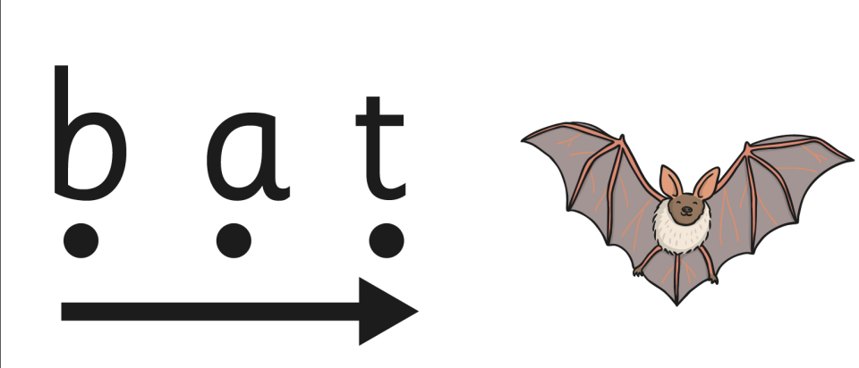
The St Peter’s Reading Journey
Step 3
Rainbow Readers
Step 4
St Peter’s Reading Challenge
Step 1
Pre-Reading Practice
Step 2
Phonic Texts

Slide 3
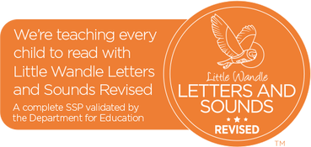

Phonics is the key
Phonic teaching starts straight away
Children learn sounds grouped by complexity. These are
divided into Phases. You can find more information on the website.
I recognise these GPCs: s, a, t, p, i, n,
How many different words might I be able to read?

Slide 4
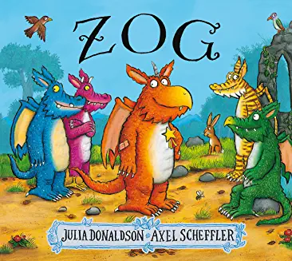

Pre-Reading Practice
When children have secure knowledge of the first set of sounds (satpin) and can blend them fluently, they will start the Phonic Texts scheme.
Before that, children will be exposed to ‘sharing books’ to encourage storytelling and a love of reading.
High Quality Stories

Slide 5

Teaching Reading with Phonic Texts
Once children can recognise the first set of GPCs (letters that represent a sound) and can blend these confidently (put GPCs together) they are ready to start reading.
30-45 mins of direct reading teaching each week (over 2-3 sessions)
In small groups
Fully trained Teacher or Teaching Assistant
Books matched to children’s secure phonic knowledge the
aim is that children can read them independently
Reading sessions focus on:
  Decoding
  Prosody
  Comprehension
Phonic Texts

Slide 6
The fluency approach
I know these sounds:
s, a, t, p, i, n, m, d, g, o, c, k, ck, e, u, r, h, b, f, l, ff, ll, s
What must it be like to be faced with a book containing GPCs and tricky words that you don’t know?
Sinbad was a sa6l9r from Bagdad. He had things to sell like 96l, ja4s and ca4pets. Sinbad sa6led t9 distant lands t9 sell his g99ds.
He set up a sh5p.
Sinbad was a sailor from Bagdad. He had things to sell like oil, jars and carpets. Sinbad sailed to distant lands to sell his goods. He set up a shop.

Slide 7
Cognitive Overload
The processes involved in reading:
What sound do this letter/ these letters represent? (is it a single sound, digraph, trigraph?)
Can I blend this word? Is it a tricky word which can’t be blended?
How do I read longer words with more than 2 syllables e.g. cobweb (chunking = cob/web )
Once children have run through these processes for 7 or 8 words, they can’t remember what the previous words are, and have no ‘space’ left to focus on understanding the story. Reading is hard work and not fun.

Slide 8

Matching books to children’s phonic knowledge reduces cognitive overload. This might mean that books seem ‘too easy’ – but it is how it should be.
After 3 reads, we are looking for children to be reading confidently at about 90-95% accuracy.
Fluency and confidence is built up by re-reading.
Developing fluency helps children to feel successful at reading. Children can read more, and engage with what they are
reading.
When children feel like successful readers, they
want to read more. Success breeds success!

Slide 9
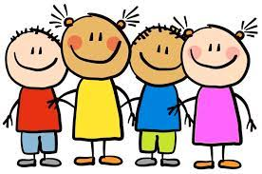
Putting it all together- an example
These children are starting Phase 3 of the Phonics programme.
They are starting to learn about vowel diagraphs – they are not
confident with these yet.
These are sounds we know
They are confidently recognising the Phase 2 sounds and can blend them to read words. Their teacher therefore chooses a book for the reading sessions that contains words using only these Phase 2 sounds.
s, a, t, p
i, n, m, d
g, o, c, k
ck, e, u, r
h, b, f, l
v, w, x, y
z/zz, w, qu, ch
sh, th, ng, nk
The children read the ‘Phase 2 book’ with the member
of staff for each reading session that week.

Slide 10

At the end of the week, children bring home a copy of their ‘Phase 2 Book’ this will be their Home Reading Book and should be read at home to show how brilliantly the children can demonstrate the skill of reading.
We ask that parents read this Home Reading Book 3 times following the same pattern as we do in school.
Decoding read – practicing blending the sounds to read the words
Prosody – reading with expression
Comprehension – thinking and talking about what happened
The book that the children are reading in school will be sent home at the end of the week.

Slide 11
Let’s watch a video from our phonics scheme ‘Little Wandle’ to summarise.
https://www.littlewandlelettersandsounds.org.uk/resources/for-parents/

