Slide 1
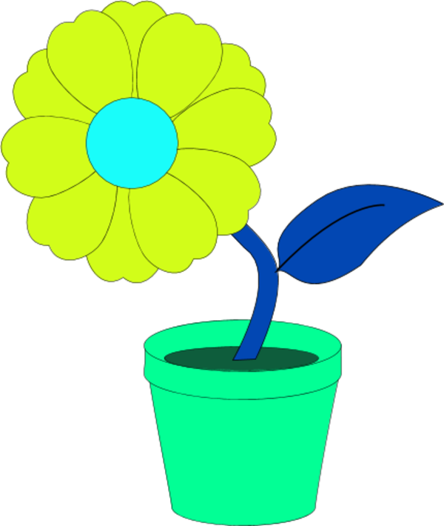
LO: I know the life cycle of a plant.

Slide 2
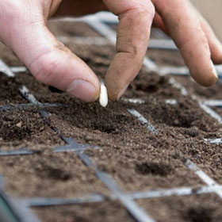
1. The seed.
The life cycle begins when the seed is planted in the ground.

Slide 3

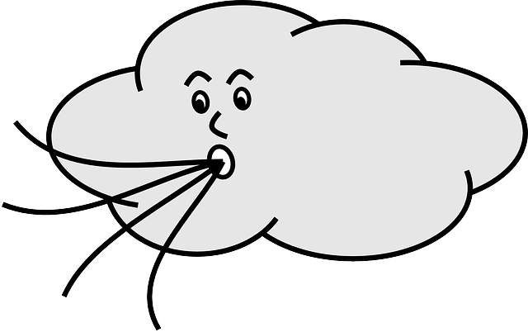
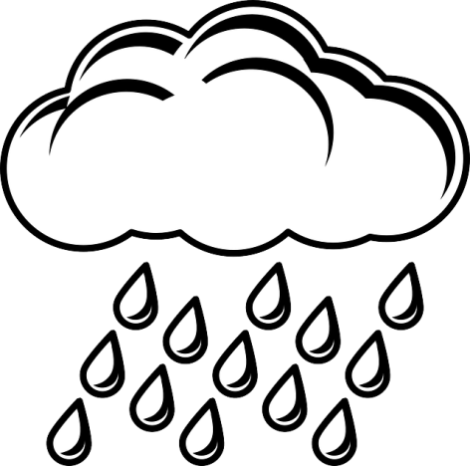
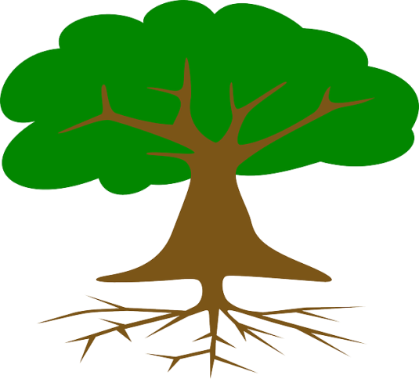
2. Growth
The seed needs certain things to be able to start growing – sunshine, water, air and nutrients.

Slide 4
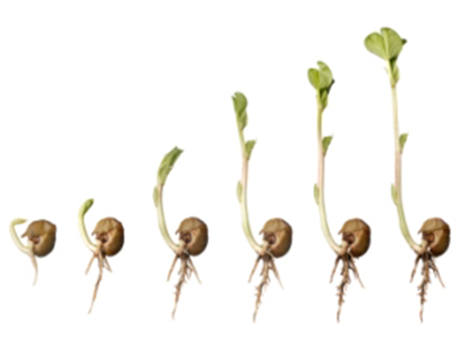
3. Germination
When the seed has had enough of these things, it sprouts and starts to grow. We call this GERMINATION.

Slide 5
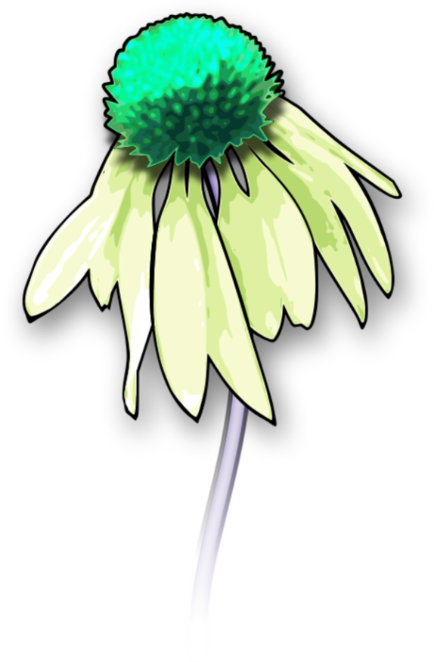
4. Reproduction
When the plant has grown, it becomes time to REPRODUCE so that new plants can grow.

Slide 6
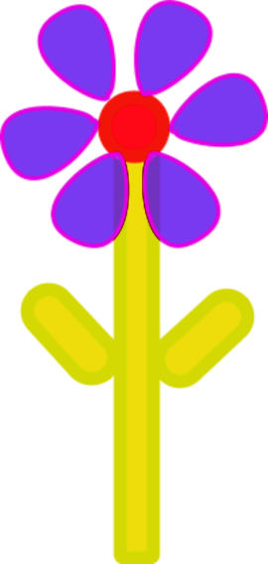
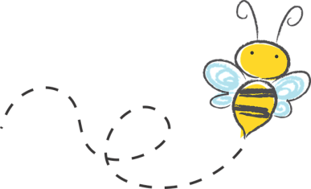
5. Pollination
In order to reproduce, a plant must combine its new baby seeds with the pollen of another plant. Insects, such as bees, pick pollen up on their legs and bodies whilst collecting nectar from a flower. They then leave this pollen behind on new plants.

Slide 7

6. Fertilisation
When the bee has left some pollen behind, the pollen joins up with the baby seeds in the plant. When they join together, this is called FERTILISATION. The seed is now ready to become it’s own plant.

Slide 8
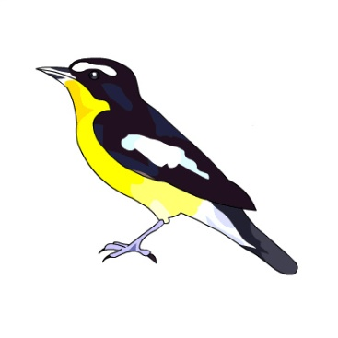
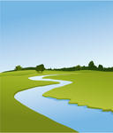
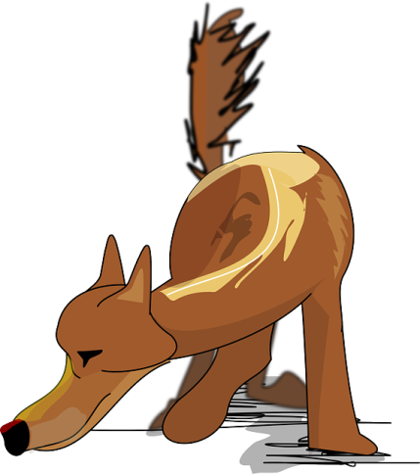
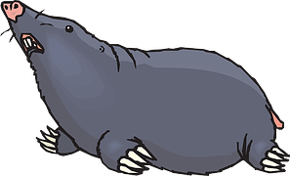
7. Seed Dispersal
Before it can grow on its own, the new seed needs to move away from the mother plant. This can happen in lots of ways – wind, by water or via birds and other animals.

Slide 9

The back to the beginning!
Once the seed has been ‘dispersed’ (taken away) then the cycle can start all over again!

