Slide 1

Year 6
Parent Meeting
Monday 15th September 2025

Slide 2
Today’s Meeting
1
2
3
4
Welcome
Curriculum
Staffing, key aims and expectations
Reading, writing, maths support and topics
Looking Forward
Diary Dates
SATs and secondary school information
Important dates, parents evenings and upcoming trips

Slide 3
1
Welcome to Year 6
Staffing, key aims and expectations

Slide 4
Chestnut Class
Class Teacher: Mrs McWilliams
Mrs Peart (Friday afternoons)
Teaching Assistants: Mrs Dunne (mornings)
Mrs Woolford (interventions)
Miss Singh and Mrs Harding
(additional support)

Slide 5
Sycamore Class
Class Teacher: Mrs Ballard
Teaching Assistants: Mrs Woolford (mornings and interventions)
Mrs Hunt and Mrs Bishop (additional support)

Slide 6
Our Key Aims
Writing
Reading
Maths
Focusing on becoming more assured and imaginative writers.
Developing the enjoyment of reading, as well as comprehension.
Embedding arithmetic and reasoning skills.
Responsibility
Independence
Enjoyment
Becoming positive role-models for the rest of the school.
Taking ownership of our learning and knowing that effort equals results.
Making life-long memories through a range of exciting experiences.

Slide 7
Our Expectations
Achievements
Transition
Mindset
To focus on learning and make progress to be proud of.
This includes, but is not exclusively, preparing for the Key Stage 2 SATs.
To be ready for the move to secondary school at the end of this year.
To maintain a growth mindset, allowing children to fully benefit from the opportunities of this year.

Slide 8
Being Prepared
water bottle (and hat in hot weather)
PE kit (Wednesdays and Fridays)
packed lunch (if needed)
pupil planner
Reading Challenge diary
homework (due Fridays)
reading book
pencil case (including a blue handwriting pen)

Slide 9
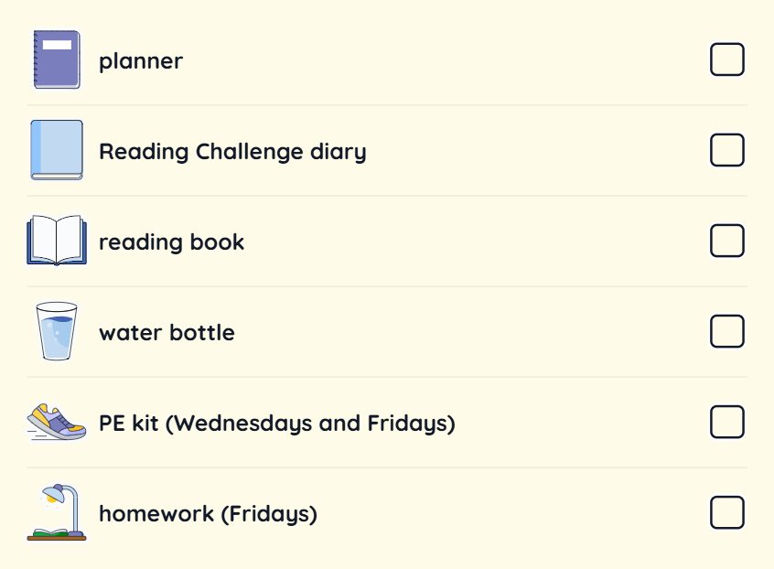
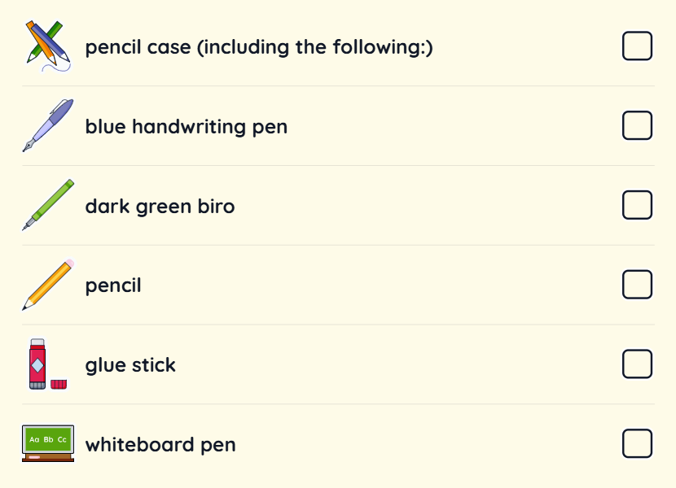
Being Prepared
Reading book
Water bottle (and hat in hot weather)
PE kit (Wednesdays and Fridays)
Packed lunch (if needed)
Pupil planner
Reading Challenge diary
Homework (due Fridays)
Pencil case (including a blue handwriting pen)

Slide 10
Rewards and Celebration
Celebration assemblies and certificates
Star of the Day
Table points
Golden Time
Winnie rewards
House points
Stickers, stamps and reward cards

Slide 11
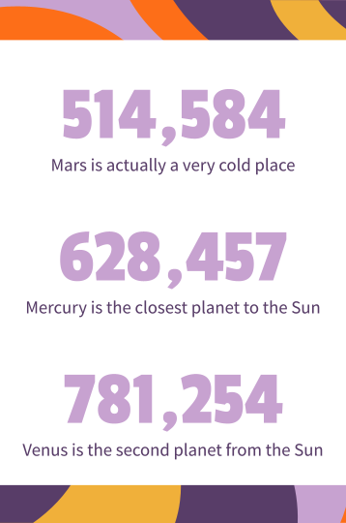
Mobile Phones
Parent permission
Turned off on school premises
Handed in to class teacher each day
Permitted for children travelling to and from school independently only.
https://docs.google.com/forms/d/e/1FAIpQLSf0QZ9QhgiIkwswxYDZfkifIkygdwZWHv3S7xRK7rGqJjSNBw/viewform

Slide 12
Homework
Travel
Please email/inform the class teacher if your child will be travelling to and/or from school independently.
The recently sent home permission forms must be completed and returned to school.
Two/three pieces each week
(usually English and Maths, plus foundation)
Weekly spelling words and Spelling Shed tasks
(beginning with recapping Year 3/4 words)
Reading Challenge
(at least three times each week for 20 minutes)
Handed out and due in on Fridays

Slide 13
2
Curriculum
Reading, writing, maths support and topics

Slide 14
Ways Of Working
Not just book work and writing
Independent, pairs, groups and whole-class
Outside when possible
Trips and visits
Mixed classes

Slide 15
Helping Your Child With Reading
Listening to your child read
Developing an enjoyment and love of reading
Reading to your child and sharing stories
Read a little at a time but often, rather than rarely but for long periods of time
Talk about the story before, during and afterwards
Look up definitions of words together
Reading can involve fiction, non-fiction, poetry, newspapers, magazines, graphic novels etc.
Visit your local library

Slide 16
Helping Your Child With Writing
Practise and learn weekly spelling lists
Encourage opportunities for writing e.g. letters, shopping lists, notes or reminders, stories or poems
Write together
Encourage use of a dictionary to check spelling and a thesaurus to find synonyms
Allow your child to use a computer for word processing, which will allow for editing and correction
Remember that good readers become good writers

Slide 17
Helping Your Child With Maths
Play times tables games
Play mental maths games including counting in different amounts, forwards and backwards
Encourage opportunities for telling the time
Encourage opportunities for counting coins and money, including amounts and change
Identify, weigh or measure quantities and amounts in the kitchen or in recipes
Play games involving numbers or logic, such as dominoes, card games, darts, draughts or chess

Slide 18
Autumn Term
Music
Dynamics, Pitch and Texture
Science
Classifying Big & Small
Light & Reflection
RE
Art
Creation & Covenant
Prophecy & Promise
Expressing Ideas
History
What Was Life Like In Tudor England?
DT
Geography
Textiles
Where Does Our Energy Come From?
PE
Computing
Cricket
Games
Gymnastics
eSafety
Systems & Networks

Slide 19
Spring Term
Science
Art
Evolution & Inheritance
Circuits, Batteries & Switches
Architecture
RE
Galilee to Jerusalem
Desert to Garden
History
DT
What Was The Impact Of WW2 On The People Of Britain?
Structures
Geography
Why Does Population Change?
PE
Computing
Games
Programming
Data & Information

Slide 20
Summer Term
Science
Art
Circulation & Exercise
Making Connections
Painting
RE
To The Ends Of The Earth
Dialogue & Encounter
History
DT
n/a
n/a
Geography
n/a
PE
Computing
Athletics
Outdoor Adventurous Activities
Programming
Creating Media

Slide 21
Assessment
Half termly formal assessment
Continuous informal assessment
Past SATs papers (first set last week w/c 08.09.25)

Slide 22
Sharing Information
Termly learning updates
Parents evenings (Autumn and Spring Terms)
End of Year Report
Arbor

Slide 23
3
Looking Forward
SATs and secondary school information

Slide 24
Secondary School Admissions
Applications are currently open.
You can choose up to six places.
Check whether any of the schools need you to fill in a Supplementary Information form, these can be obtained from the school and need to be returned to the school directly. If you do not fill this in for the relevant school your application may not be placed in the correct criteria for your child.
It is recommended that you visit schools you are interested in during the day as this gives you and your child a genuine and real impression of the setting in action. Please let us know in advance of the appointment you have made.
If you have any concerns or questions please do come and see us, or speak to Mrs Cardy.
We are hosting a further information session about this on Tuesday 23rd September at 6pm.
Closing Date: 31st October 2025
Notification of Places: 2nd March 2026

Slide 25
Key Stage 2 SATs
Scaled scores are given for:
Grammar, Punctuation and Spelling (combined)
Reading
Maths (combined)
The range of these scores is 80 to 120.
A scaled score:
Below 100 means your child is working towards the expected standard
Above 100 means your child is working at the expected standard
Above 110 means your child is working above the expected standard
SATs Week: w/c Monday 11th May 2026
SATs Results: early July 2026
Monday Grammar, Punctuation and Spelling
Paper
Spelling Paper
Tuesday Reading Paper
Wednesday Arithmetic Paper
Reasoning Paper
Thursday Reasoning Paper

Slide 26
Helping Your Child
Support the completion of homework given
Talk about what your child has read and complete Reading Challenge diary questions
Support regular rehearsal of key skills e.g. times tables, spellings, wider vocabulary, grammar, calculations etc.
Encourage independence where possible
Help on trips/visits if able

Slide 27
4
Diary Dates
Important dates, parents evenings and upcoming trips

Slide 28
Diary Dates 2025-26
Friday 1st September Secondary school applications open
Tuesday 23rd September Secondary school admissions meeting (6pm)
Friday 3rd October Grandparents day (9.30am onwards)
Tuesday 7th October STEAM Trip to Thorpe Park
Friday 31st October Secondary school applications close
Tuesday 11th November RSE and Osmington Bay Information Meeting (5.30pm)
Wednesday 12th November Reception and Year 6 Welcome Liturgy (9.15am)
Wednesday 19th November Parents evening (3.40pm onwards)
Monday 24th November Parents evening (3.30pm onwards)
Thursday 11th December Visit to Hampton Court Palace
Wednesday 17th December Carol Service (10.30am)
Monday 2nd March Secondary school places announced (evening)
Monday 11th May – Thursday 14th May KS2 SATs Week
Sunday 14th June – Wednesday 17th June Residential trip to Osmington Bay PGL

Slide 29
Further Information
Hampton Court (date confirmation and payments)
Osmington Bay (parent meeting and payments)
Swimming
Bike Ability
RSE (parent meeting and information)
Leavers’ Events (play, Liturgy, Business Enterprise)
Please keep an eye out on Arbor for more information on the upcoming events in Year 6...

Slide 30

Thank You!
Do you have any questions?
alex.mcwilliams@stpeters-leatherhead.surrey.sch.uk
clair.ballard@stpeters-leatherhead.surrey.sch.uk

