Slide 1

Year 5
Parent Meeting
Friday 18th September 2026

Slide 2
Hawthorn
Class
Class Teachers: Miss Shaw
Teaching Assistants:
Mrs Krichauff
Miss Singh
Mrs Taylor

Slide 3
Poplar Class
Class Teacher: Mrs Davies
Teaching Assistants: Mrs Latham
Mrs Green
Miss Singh

Slide 4
Our Key Aims
Writing
Reading
Maths
Focusing on becoming more assured and imaginative writers.
Developing the enjoyment of reading, as well as comprehension.
Embedding arithmetic and reasoning skills.
Responsibility
Independence
Enjoyment
Becoming positive role-models for the rest of the school.
Taking ownership of our learning and knowing that effort equals results.
Making life-long memories through a range of exciting experiences.

Slide 5
Our Expectations
Achievements
Transition
Mindset
To focus on learning and make progress to be proud of.
We celebrate and recognise effort through positive praise/ house points and celebration assembly
To be ready for the move to Year 6 at the end of this year.
Resilience
Perseverance
The wish to be the best they can be!
To maintain a growth mindset, allowing children to fully benefit from the opportunities of this year.

Slide 6
Being Prepared
PE kit
(Wednesday and Thursday)
10 weeks of swimming Supportive trainers – no earrings
Water bottle (and hat in hot weather)
Pencil case (including a blue handwriting pen, gluestick, pencil and long ruler)
Packed lunch (if needed)
Reading record
Homework (given out on Friday and due the following Friday)
Reading book (in school everyday)
Correct school uniform
(No trainers or fleeces on non PE days, earrings out please.)

Slide 7
Homework
Handed out on Friday and due in by the following Friday.
They can bring it in earlier than Friday.
Two/three pieces each week
Usually English (spelling or grammar) and Maths (arithmetic or linked to topic), plus foundation task as and when needed.
Weekly spelling words
(Beginning with recapping Year 3/4 words and then moving onto the Year 5/6 words.)
Reading Record
(at least four times each week for 20 minutes)

Slide 8
Helping Your Child With Reading
Listening to your child read
Developing an enjoyment and love of reading
Reading to your child and sharing stories
Read a little at a time but often, rather than rarely but for long periods of time
Talk about the story before, during and afterwards
Look up definitions of words together
Reading can involve fiction, non-fiction, poetry, newspapers, magazines, graphic novels etc.
Visit your local library

Slide 9
Helping Your Child With Writing
Practise and learn weekly spelling lists
Encourage opportunities for writing e.g. letters, shopping lists, notes or reminders, stories or poems
Write together
Encourage use of a dictionary to check spelling and a thesaurus to find synonyms
Allow your child to use a computer for word processing, which will allow for editing and correction
Remember that good readers become good writers

Slide 10
Helping Your Child With Maths
Play times tables games
Play mental maths games including counting in different amounts, forwards and backwards
Encourage opportunities for telling the time
Encourage opportunities for counting coins and money, including amounts and change
Identify, weigh or measure quantities and amounts in the kitchen or in recipes
Play games involving numbers or logic, such as dominoes, card games, darts, draughts or chess
Encourage your child to show their working out when doing arithmetic calculations and ask them to explain how they came to an answer.

Slide 11
Autumn Term
Science
Art
Materials: mixtures and separation
Properties and changes
Drawing: depth, emotion and movement
RE
Creation & Covenant
Prophecy & Promise
History
DT
What is the legacy of the ancient Greek civilization?
Mechanical Systems – Making pop up books
Geography
What is life like in the Alps?
PE
Computing
Dance/Gymnastics
Swimming
Ball skills
eSafety
Search engines and Scratch coding using sound blocks

Slide 12
Spring Term
Science
Forces, Earth and Space
Living things, lifecycles and reproduction
Art
Painting & mixed media portraits
RE
Galilee to Jerusalem
Desert to Garden
History
DT
Were the Vikings raiders, traders or something else?
Structures - bridges
Geography
Why do oceans matter?
PE
Computing
Games
Ball skills continued
E-safety, Data handling
Microbits

Slide 13
Summer Term
Science
Unbalanced Forces
Animals: human timeline
Art
3D art installations
RE
To The Ends Of The Earth
Dialogue & Encounter
History
DT
Geography
What can the census tell us about local areas?
Cooking & Nutrition
Would you like to live in the desert?
PE
Computing
Athletics
Team sports
Stop motion animation
Creating Media

Slide 14
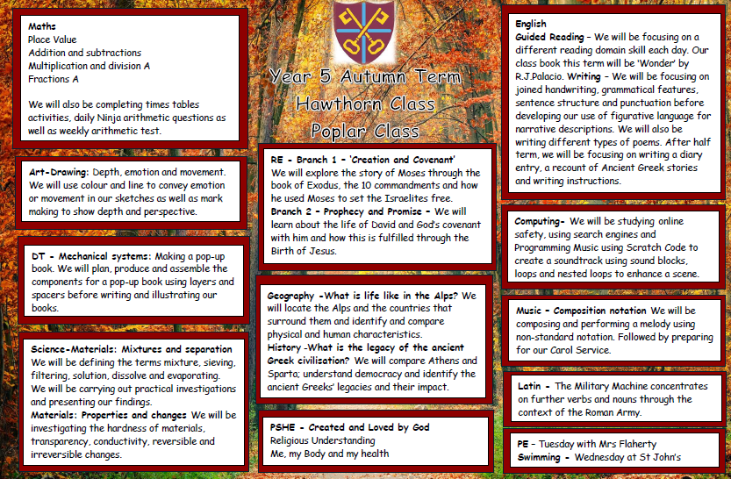
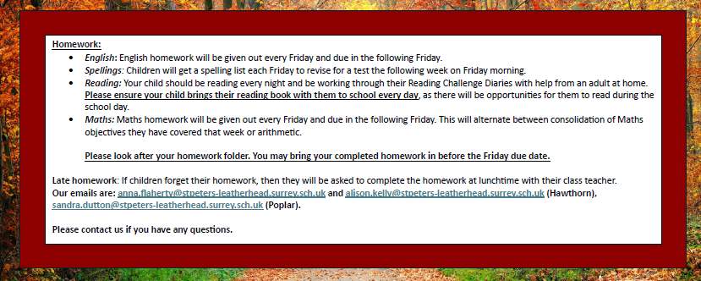
Sharing Information
Termly learning overviews on the website
Parents evenings
(Autumn and Spring Terms)
End of Year Report
Parent messages via Arbor

Slide 15
Helping Your Child
Support the completion of homework given
Talk about what your child has read and complete Reading Challenge diary questions
Support regular rehearsal of key skills e.g. times tables, spellings, wider vocabulary, grammar, calculations etc.
Encourage independence where possible.
Help on trips/visits/swimming if you are able.

Slide 16
Diary Dates
Trips and Visits:
Swimming: 9/9/26 -18/11/26
Viking Day: 9/3/27
Henley Fort: 17-19/5/27

Slide 17
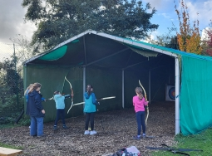
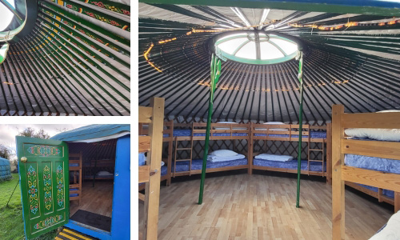
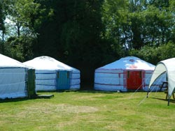
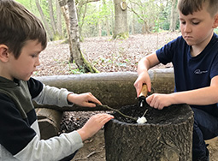
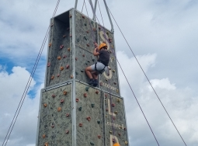
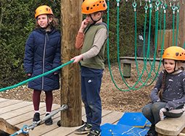
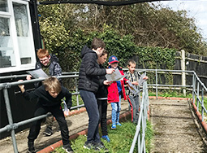
Henley Fort

Slide 18
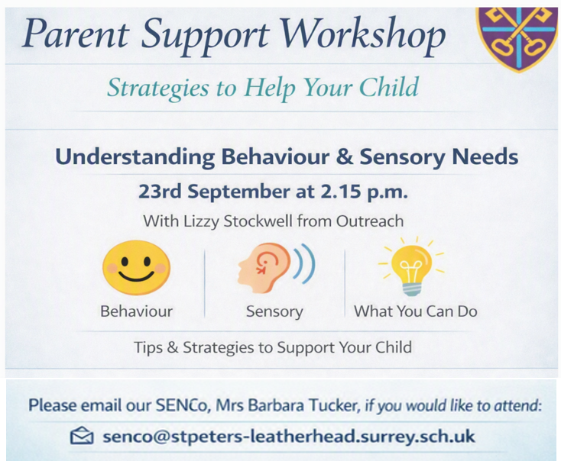

Slide 19

Thank You!
Do you have any questions?
c.shaw@stpeters-leatherhead.surrey.sch.uk
daniela.davies@stpeters-leatherhead.surrey.sch.uk

