Slide 1

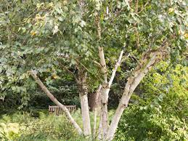
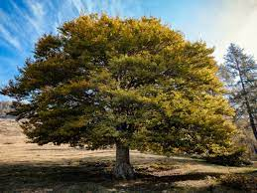
Meet the Teacher
Year 3
Birch class
Mrs Ballard
with
Mrs Hunt
Elm class
Mrs Williams and Mrs Zad
with
Mrs Bishop, Mrs Earle and Mrs Hunt

Slide 2
What your child needs
Every day, your child needs
  a reading book and reading diary
  a water bottle
  a bag.
Our PE days are Monday and Tuesday but this could change.
Notes:
‹#›

Slide 3
Daily Routine
Your child/children’s day could look like this:
8:40 Soft Start for 8:50 registration
9:00 Assembly
9:30 English and Reading
10:40 Break on the field or playground
10:55 Maths
12:00 Lunch on the field or playground
1:00 RE
2:00 Daily Mile on the playground
2:10 History
3:10 Pack up
3:20 Home Time
Notes:
‹#›

Slide 4
Expectations
100% attention from all children.
Listen and follow instructions given by any adult at all times.
Follow school rules.
Wear correct uniform, including hair accessories.
These are all applied consistently across the whole school.
Notes:
‹#›

Slide 5
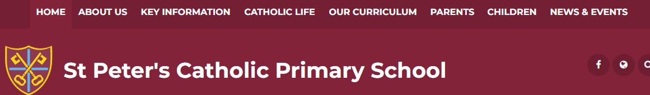
Expectations
Please refer to website for further details regarding our behaviour policy, daily routines, uniform etc.
  KEY reminder regarding PE – NO earrings. If your child does come into school wearing them, they MUST remove them beforehand and put them into a safe place within their own school bag.
Notes:
‹#›

Slide 6
Curriculum
English - includes reading, writing, GPS
Maths
Science
RE
PE – could be indoors or outdoors
Computing
Music
History
Geography
Art and Design
Design and Technology

Slide 7
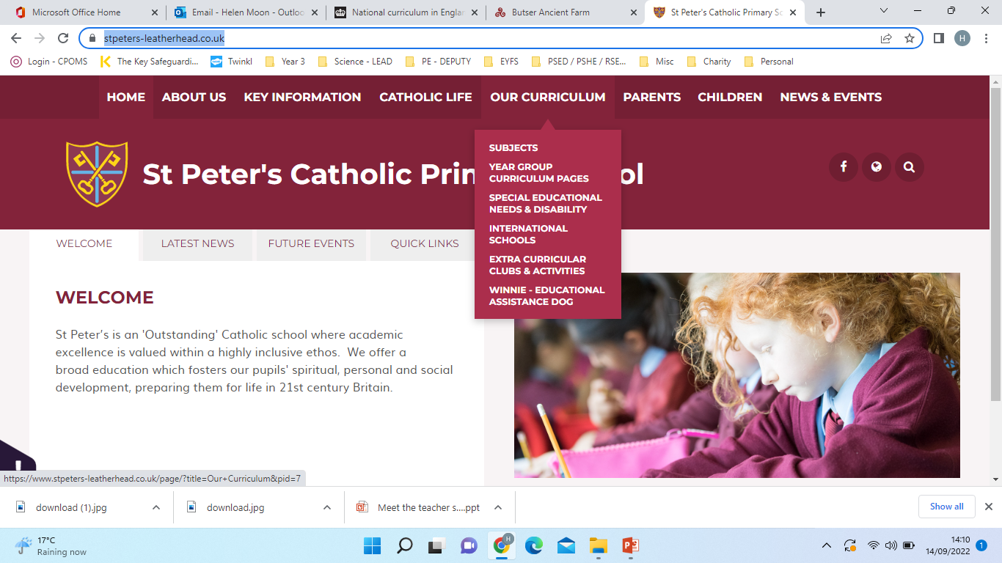
Curriculum
Please refer to the school’s website for more in depth detail about your child’s learning during Year 3.
https://www.stpeters-leatherhead.co.uk/

Slide 8
Reading
Your child should be reading at home (preferably daily) and working through their reading book with the help of an adult - please sign your child’s reading journal 4 times a week.
We will give new books out every two weeks.

Slide 9
Spellings
Your child will come home with their weekly spellings on Fridays and will be tested the following Friday. Please make sure that your child learns how to spell the words on their list and also knows what each word means in different contexts.
Spelling asks will be set on EdShed on the same day the spellings are sent home.

Slide 10
Times Tables
By the end of Year 3, in addition to their KS1 skills and knowledge, your child should be able to
  recall and use multiplication and division facts for the 3, 4 and 8 multiplication tables
  write and calculate mathematical statements for multiplication and division using the multiplication tables that they know, including for two-digit numbers times one-digit numbers, using mental and progressing to formal written methods
  solve problems, including missing number problems, involving multiplication and division, including positive integer scaling problems and correspondence problems in which n objects are connected to m objects.
We will be practicing times tables in class and practice can be done at home via Time Tables Rock Stars – log-ins will come out soon!

Slide 11
Homework
Homework will be given on Fridays.
It could include English, maths, spellings and/or a piece of foundation work.
Children have until the next Friday to complete the homework. If it is not brought in, an extension will be given until Monday. If it is still not brought in, they may spend 20 minutes completing it with a teacher.
If your child is struggling with any homework, they can bring it to us for help.

Slide 12
Trips & workshops - TBC
Feet First Walking – road safety
Egyptian Workshop - History
Wakehurst - Science (plants)
Hopefully a volcanoes Virtual Reality (VR) experience - Geography

Slide 13
School website
This is a great place to look for any general FAQs you may have.
https://www.stpeters-leatherhead.co.uk
If in doubt, please contact the school office or your child’s class teacher:
Mrs Ballard - Birch
clair.ballard@stpeters-leatherhead.surrey.sch.uk
Mrs Williams - Elm
A.Williams@stpeters-leatherhead.surrey.sch.uk
Mrs Zad – Elm
sara.zad@stpeters-leatherhead.surrey.sch.uk

Slide 14


Slide 15
Any questions?

